Slide 1
Smart Attendance System
Using Face Recognition
Institution Name: Indus University
Department: IICT
Course/Sem. : MSC-IT / 3 - C
Project Guide/Mentor: Ms. Archana Srivastava
Team Members:
  Yash Italiya : [IU2554100005]
  Ashish Vaghasiya : [IU2554100015]

Slide 2
Introduction
Overview: A modern, automated web-based application designed to streamline attendance tracking.
  Core Objective: Eliminate manual roll-calls and proxy attendance.
  Leverages advanced biometric face recognition and liveness detection.
Technology Stack:
  Frontend: HTML,CSS(BOOTSTRAP),JS, AJAX
  Backend: Python, Flask Framework
  Database: MySQL
  AI/CV Engine: OpenCV, face_recognition library(dlib)
  Plateform : VS CODE

Slide 3
Existing System
Manual Roll-Call:
  Faculty calling names or passing around sheets during class.
Legacy ERP Entry:
  Faculty manually entering data into portals after class.
Traditional Biometrics:
  Shared RFID cards or fingerprint scanners at classroom doors.

Slide 4
Problem Areas of Existing System
Time Consumption: Wastes 5-10 minutes of valuable instructional time.
Proxy Attendance: High risk of buddy punching (fake attendance).
Administrative Burden: Manual percentage calculations and absentee management.
Hygiene & Bottlenecks: Fingerprint scanners create long queues and pose hygiene concerns.

Slide 5
Need for the New System
Complete Automation:
  Zero-touch, self-service attendance linked to live class schedules.
Uncompromised Security:
  Advanced anti-spoofing pipeline ensures strict liveness detection.
High Precision Accuracy:
  Deep learning-based 128-d face encodings provide highly accurate matches.
Real-Time Analytics:
  Instant, role-based dashboards for students and faculty.

Slide 6
System Flow Diagram

Slide 7
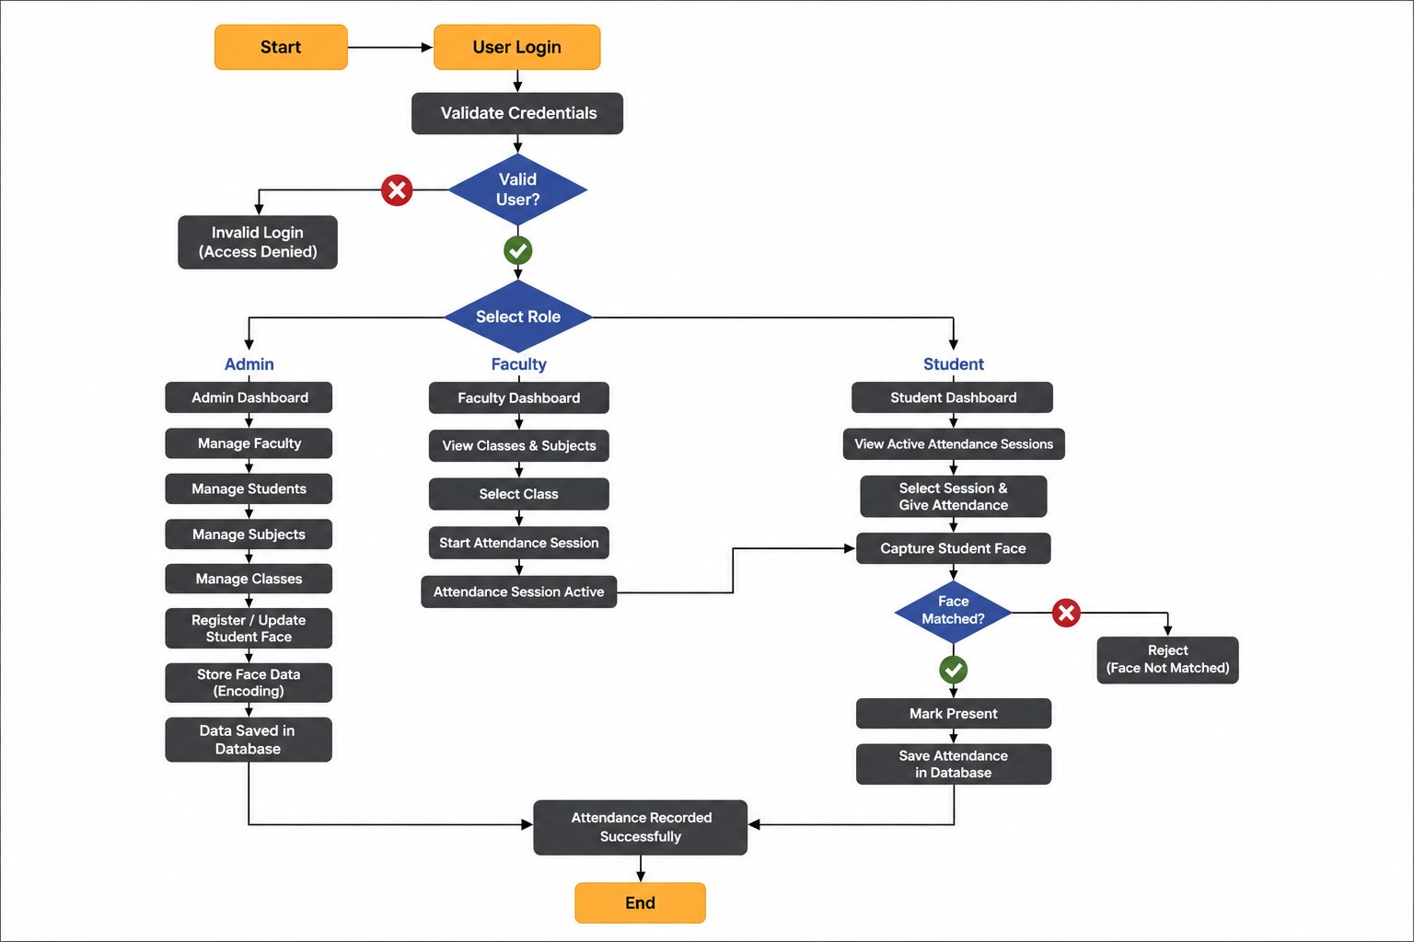

Slide 8
Data Dictionary

Slide 9
Table: roles
Field | Data Type | Description
role_id | INT | Unique role ID (PK)
role_name | VARCHAR(100) | Admin / Faculty / Student

Slide 10
Table: users
Field | Data Type | Description
user_id | INT | Unique user ID (PK)
role_id | INT | User role (FK)
full_name | VARCHAR(100) | User's full name
email | VARCHAR(50) | Login email
password | VARCHAR(255) | Hashed password
profile_img | VARCHAR(100) | Profile image path
status | INT | Account status
created_at | TIMESTAMP | Account creation time

Slide 11
Table: students
Field | Data Type | Description
student_id | INT | Unique student ID (PK)
user_id | INT | Linked user ID (FK)
course_id | INT | Student course (FK)
semester_id | INT | Student semester (FK)
face_registered | TINYINT(1) | Face registration status

Slide 12
Table: faculty
Field | Data Type | Description
faculty_id | INT | Unique faculty ID (PK)
user_id | INT | Linked user ID (FK)
designation | VARCHAR(100) | Faculty designation

Slide 13
Table: courses
Field | Data Type | Description
course_id | INT | Unique course ID (PK)
course_name | VARCHAR(100) | Course name
course_code | VARCHAR(20) | Unique course code

Slide 14
Table: semesters
Field | Data Type | Description
semester_id | INT | Unique semester ID (PK)
semester_name | VARCHAR(30) | Semester name

Slide 15
Table: subjects
Field | Data Type | Description
subject_id | INT | Unique subject ID (PK)
course_id | INT | Linked course (FK)
semester_id | INT | Linked semester (FK)
faculty_id | INT | Assigned faculty (FK)
subject_name | VARCHAR(100) | Subject name
subject_code | VARCHAR(20) | Unique subject code

Slide 16
Table: face_data
Field | Data Type | Description
face_id | INT | Unique face record ID (PK)
student_id | INT | Linked student (FK)
image_path | VARCHAR(255) | Registered face image path
face_encoding | MEDIUMTEXT | Stored facial encoding

Slide 17
Table: classes
Field | Data Type | Description
class_id | INT | Unique class ID (PK)
subject_id | INT | Class subject (FK)
faculty_id | INT | Class faculty (FK)
class_date | DATE | Date of class
start_time | TIME | Class start time
end_time | TIME | Class end time
attendance_started | TINYINT(1) | Attendance session status

Slide 18
Table: attendance
Field | Data Type | Description
attendance_id | INT | Unique attendance ID (PK)
class_id | INT | Related class (FK)
student_id | INT | Student (FK)
attendance_time | DATETIME | Attendance time
status | VARCHAR(10) | Present / Absent
confidence_score | DECIMAL(5,2) | Face-match confidence

Slide 19
Table: feedback
Field | Data Type | Description
feedback_id | INT | Unique feedback ID (PK)
name | VARCHAR(50) | Sender's name
email | VARCHAR(50) | Sender's email
subject | VARCHAR(100) | Feedback subject
message | TEXT | Feedback message

Slide 20
Use Case Diagram

Slide 21
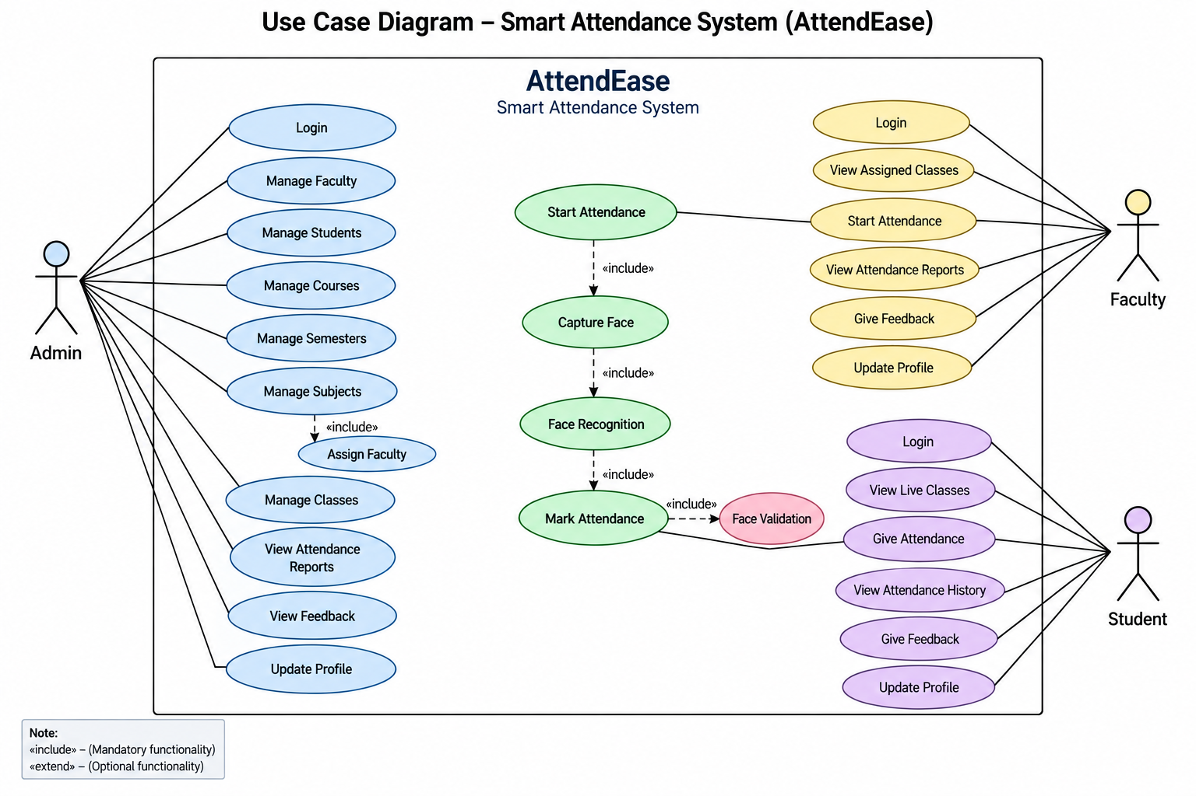

Slide 22
Activity Diagram

Slide 23
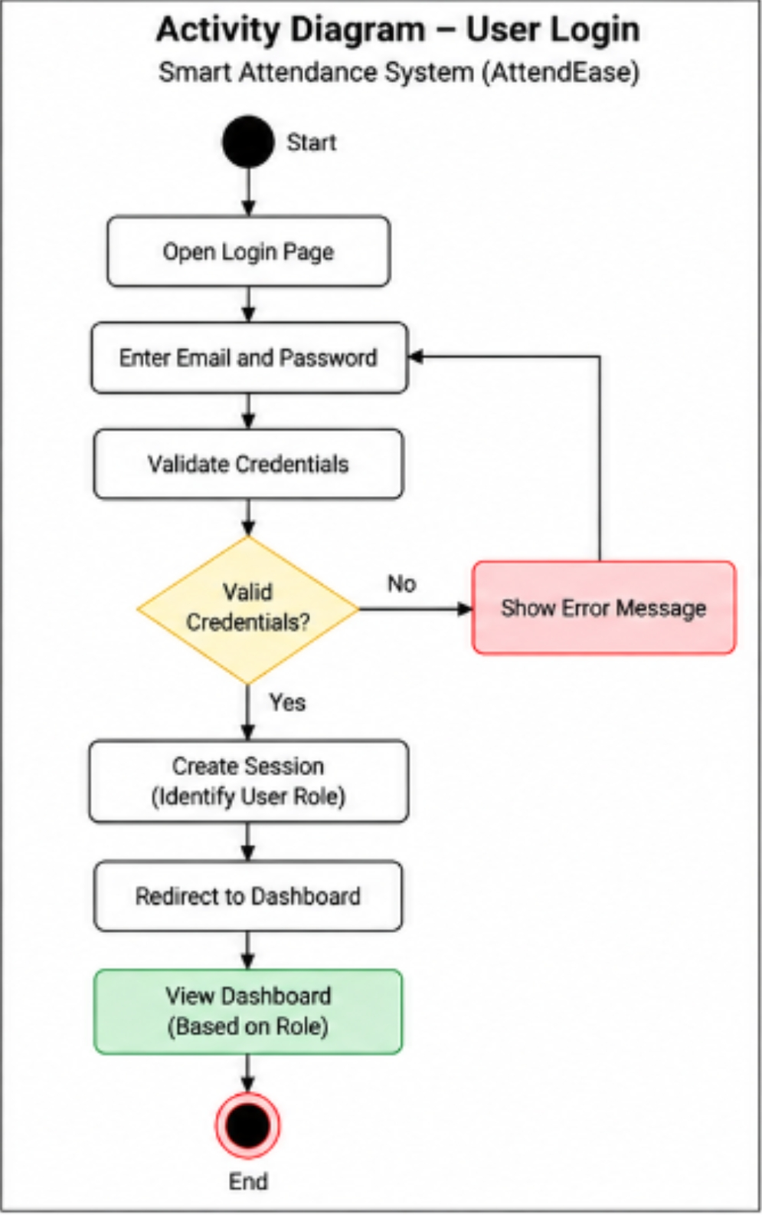

Slide 24
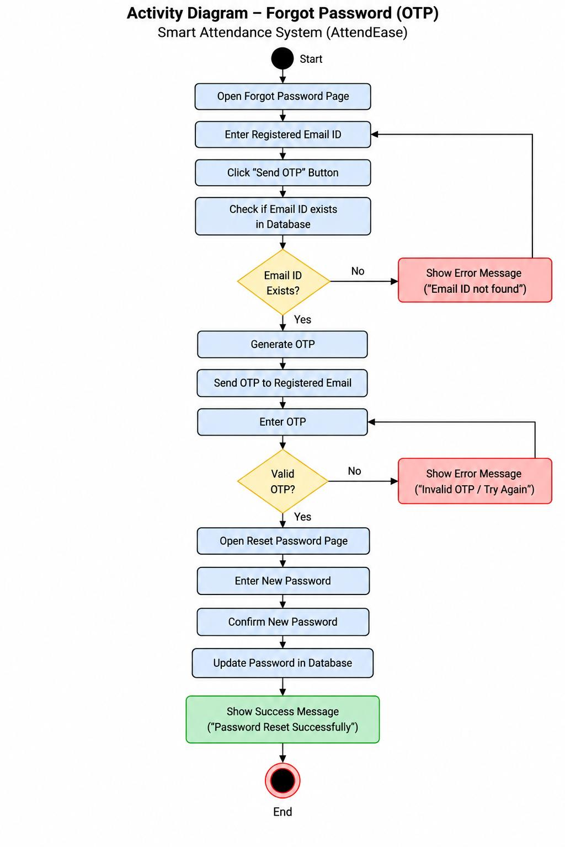

Slide 25
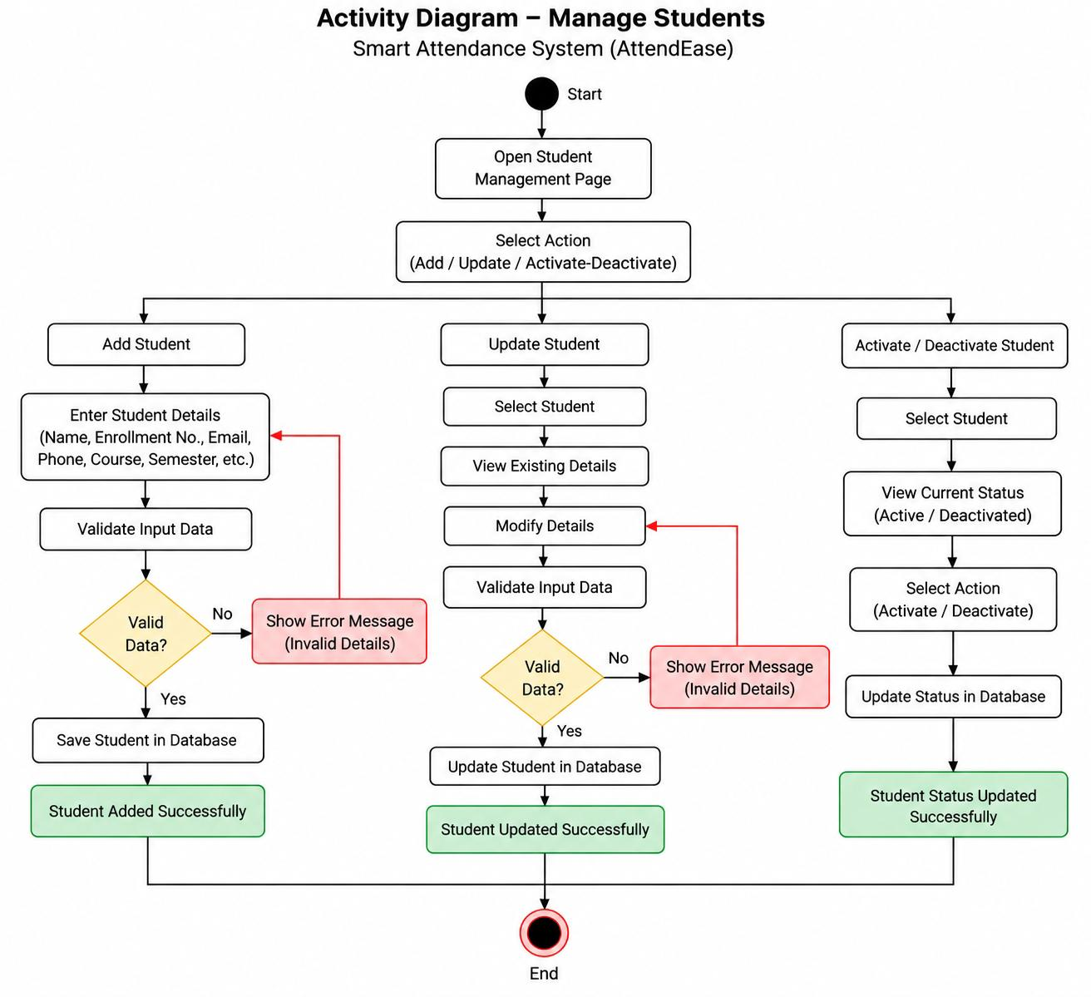

Slide 26
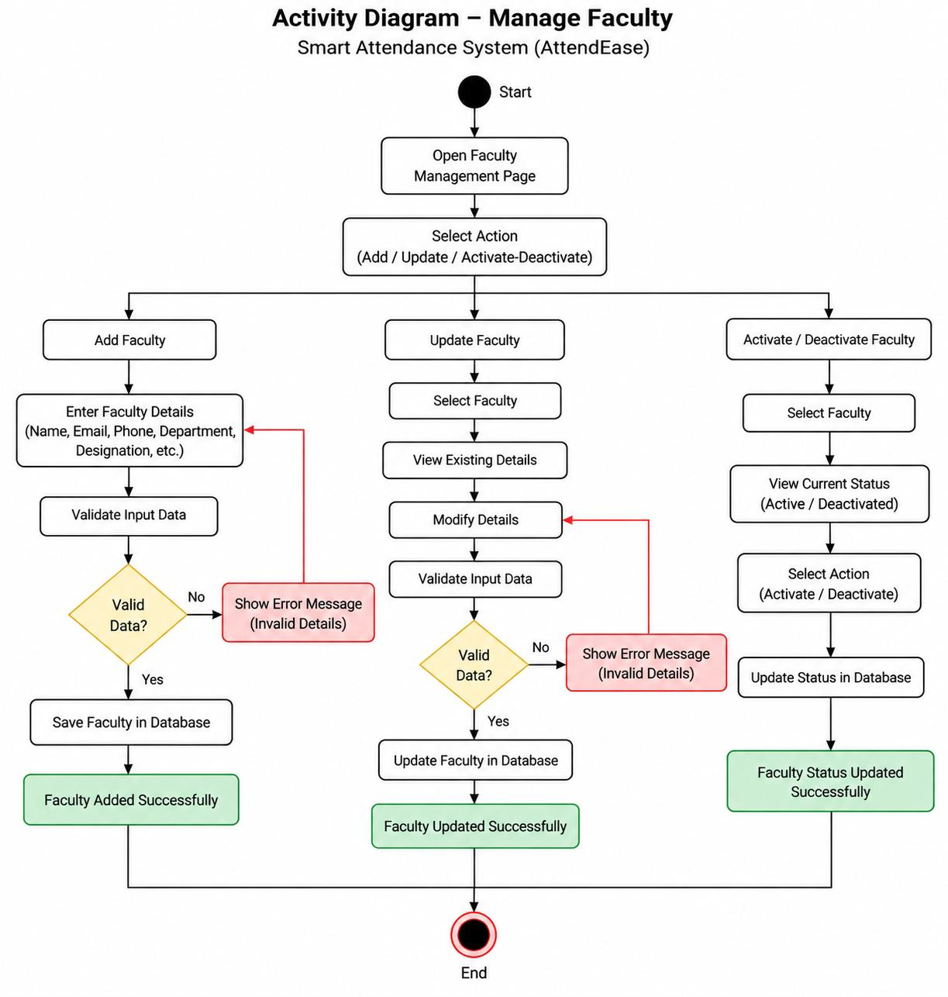

Slide 27
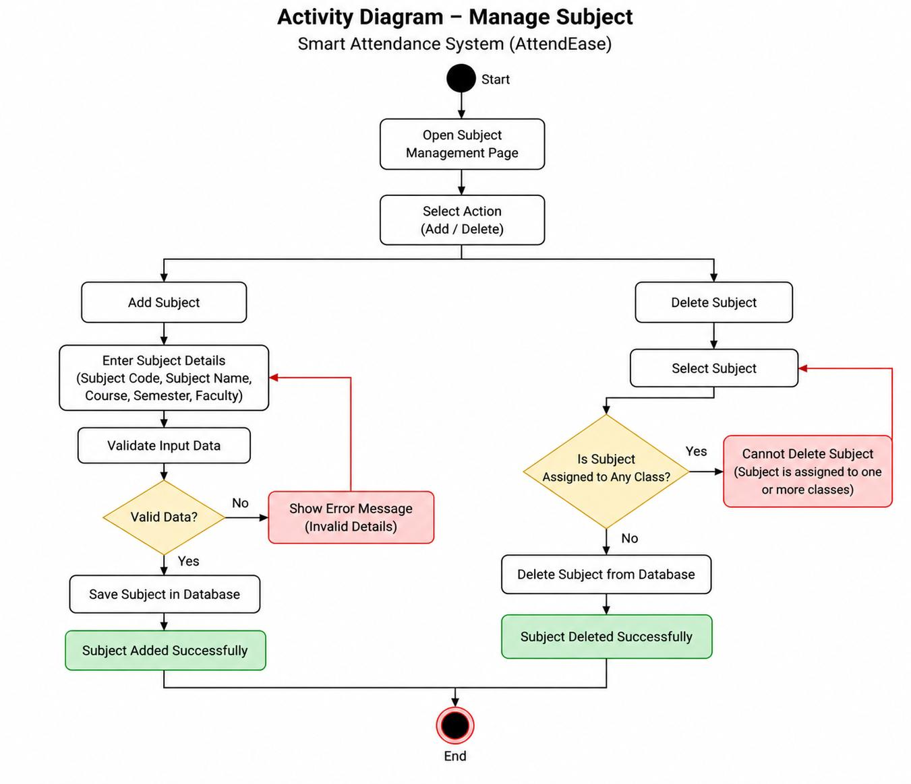

Slide 28
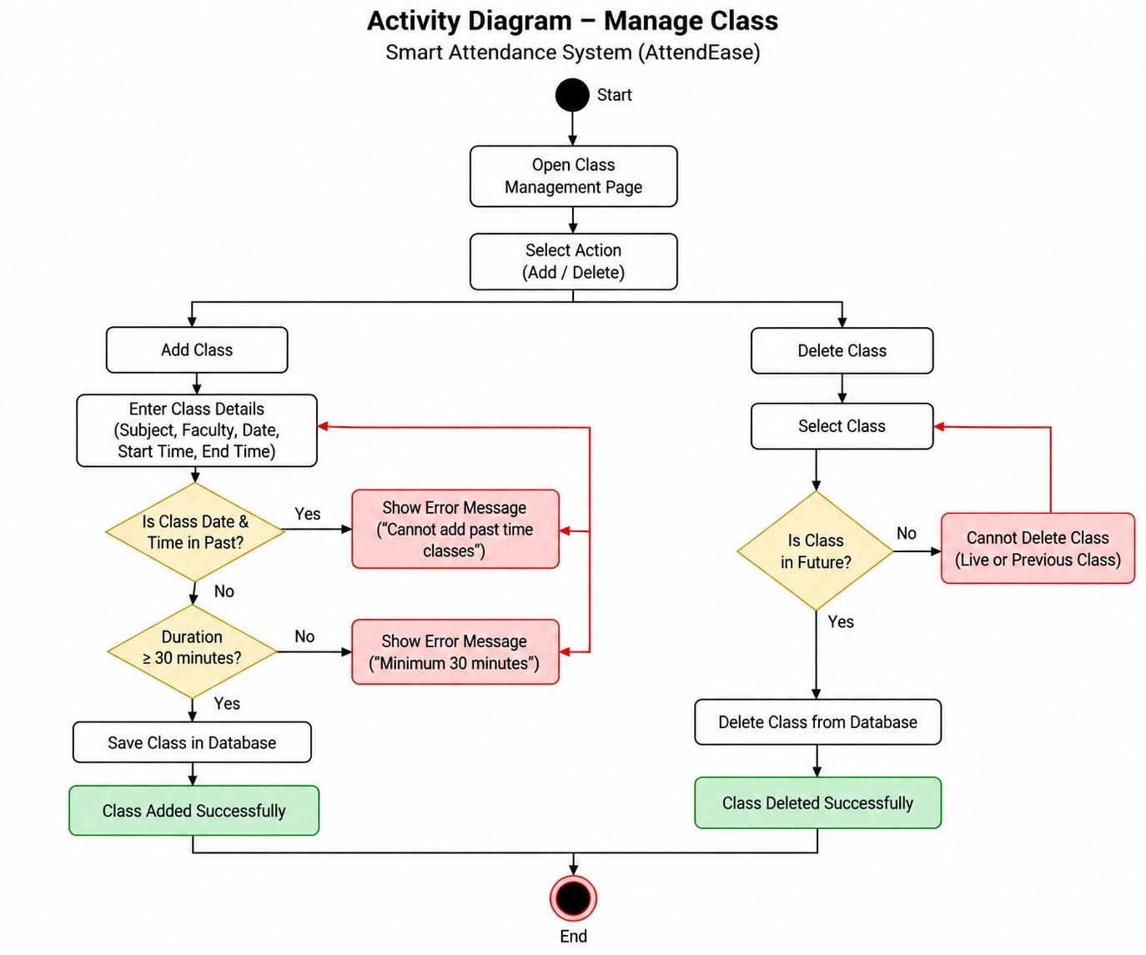

Slide 29
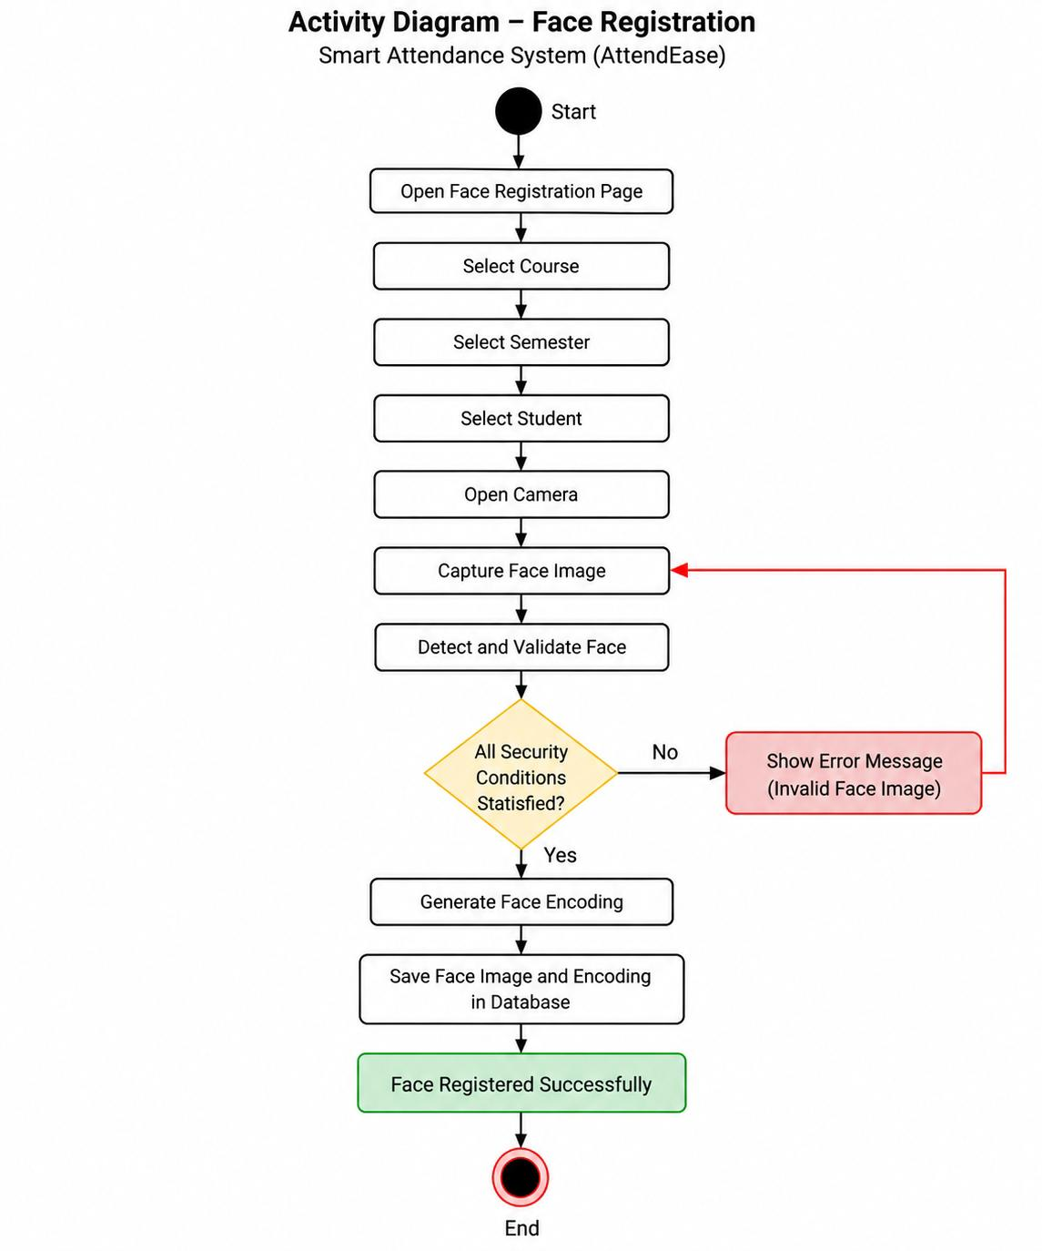

Slide 30
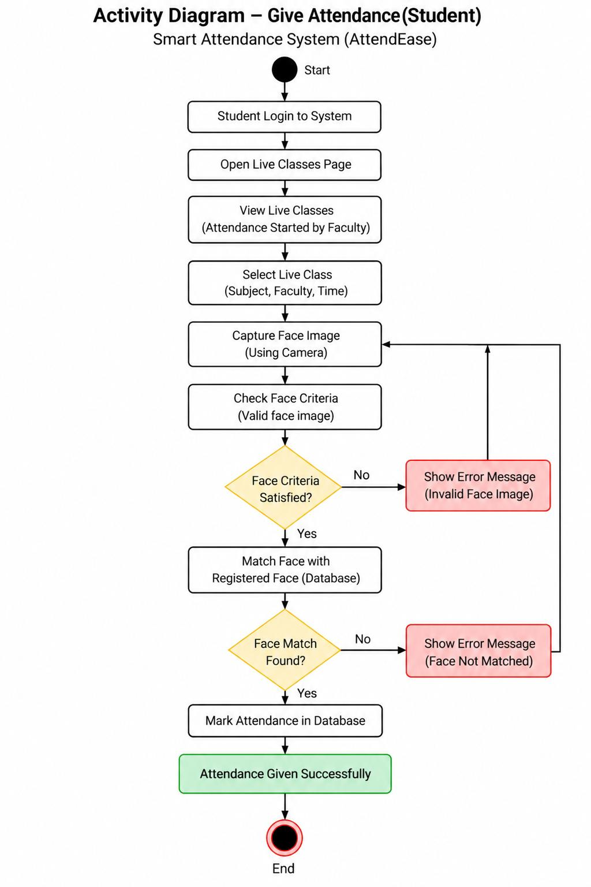

Slide 31
User Interface Screens

Slide 32
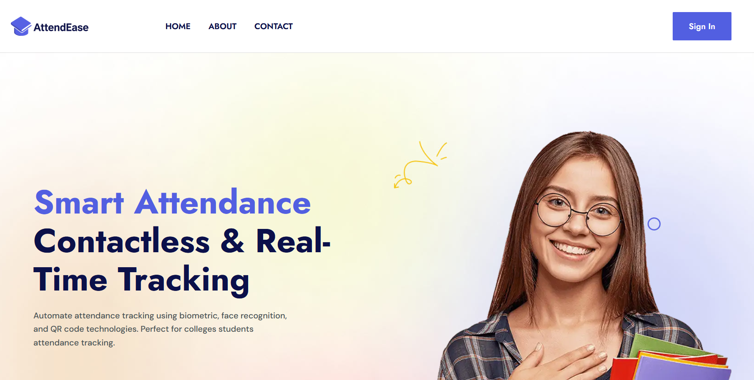
HOME PAGE

Slide 33
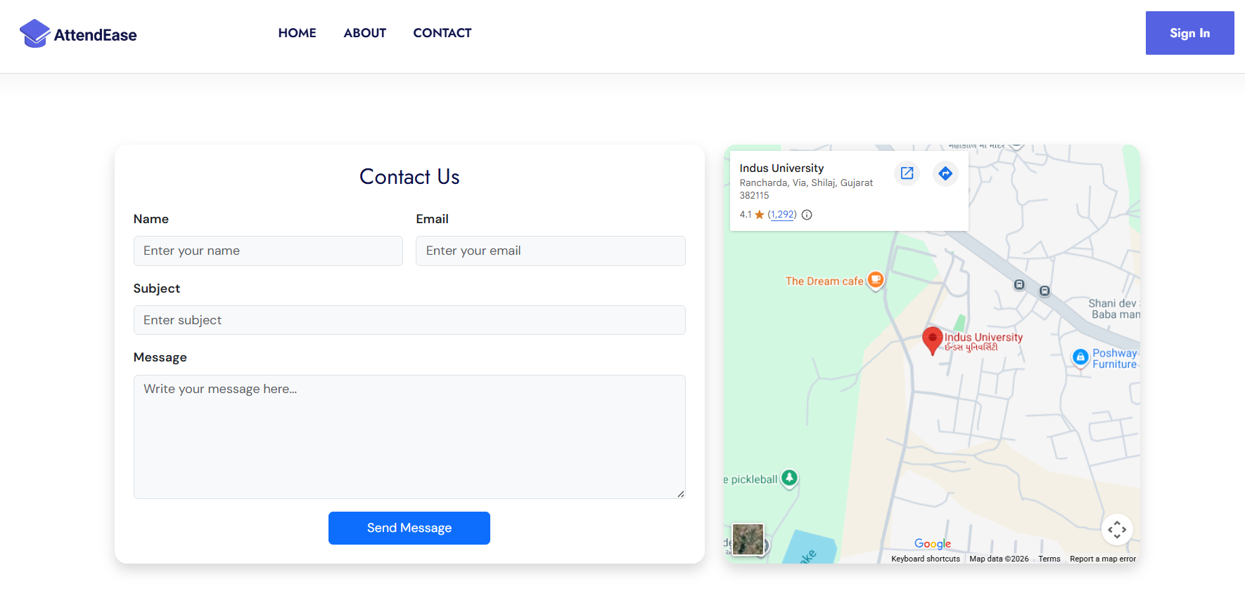
CONTACT-US PAGE

Slide 34
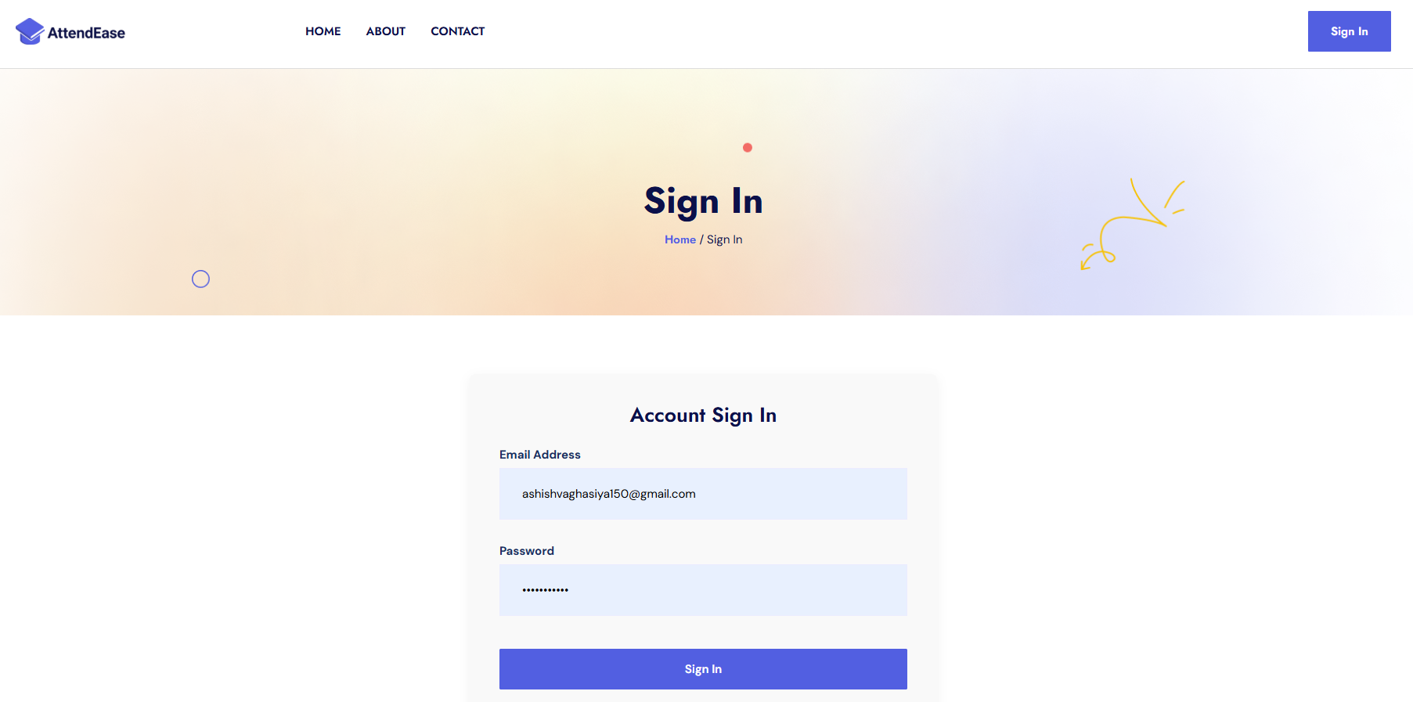
LOGIN PAGE

Slide 35
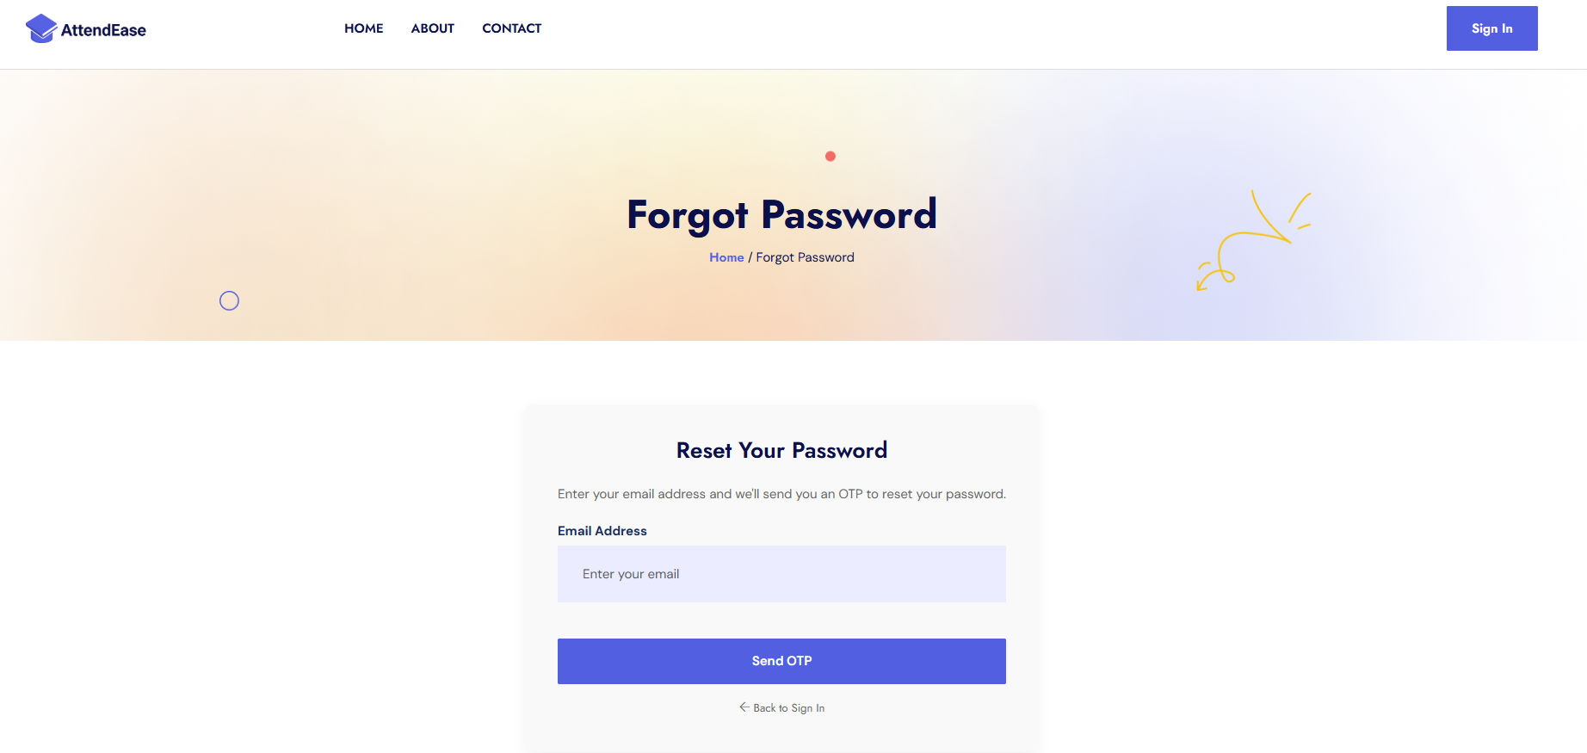
FORGOT PASSWORD PAGE

Slide 36
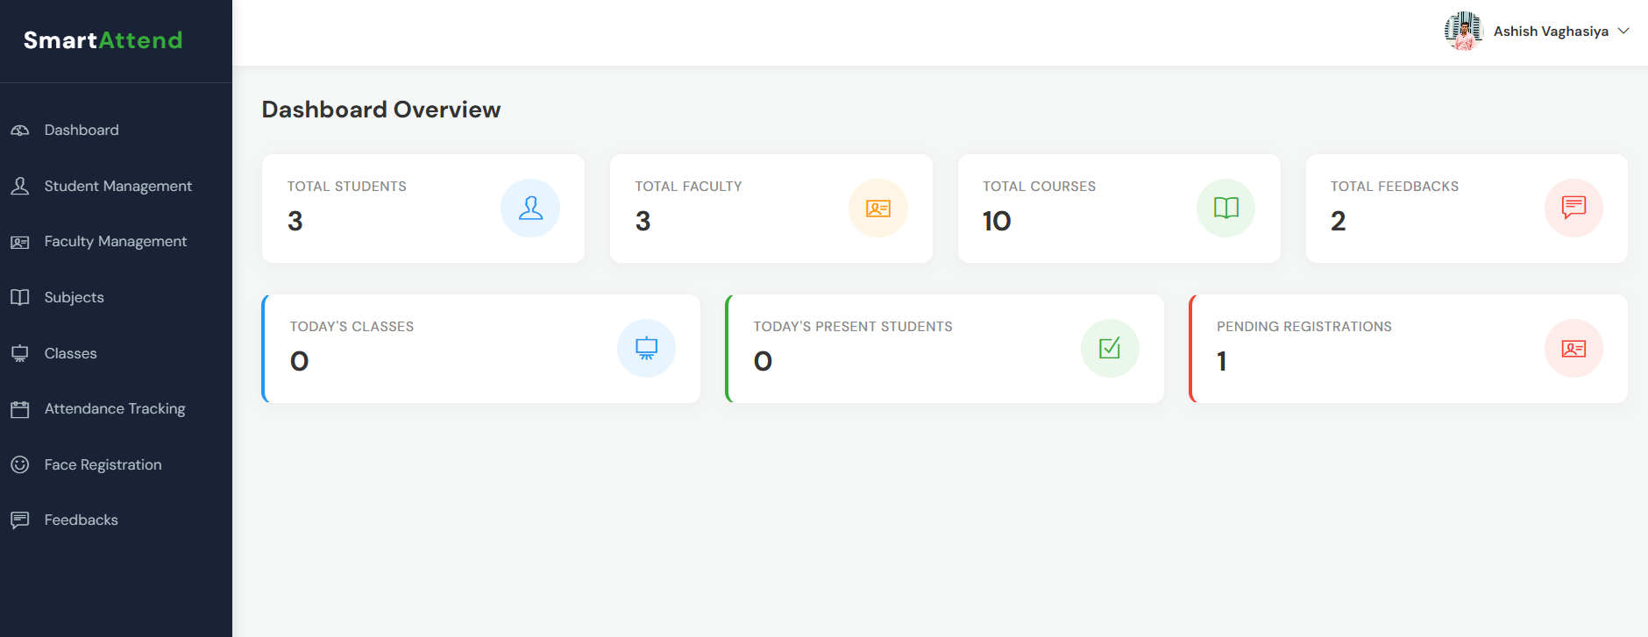
ADMIN DASHBOARD

Slide 37
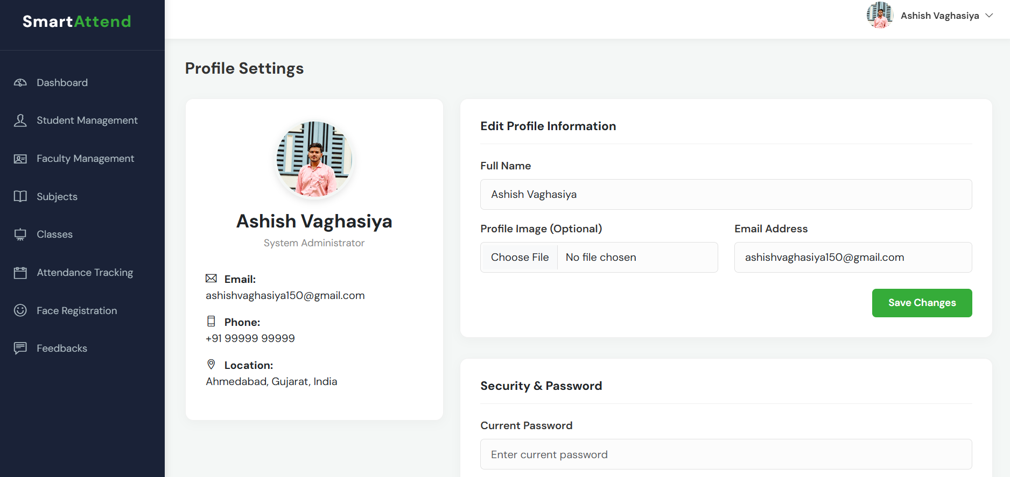
ADMIN PROFILE

Slide 38
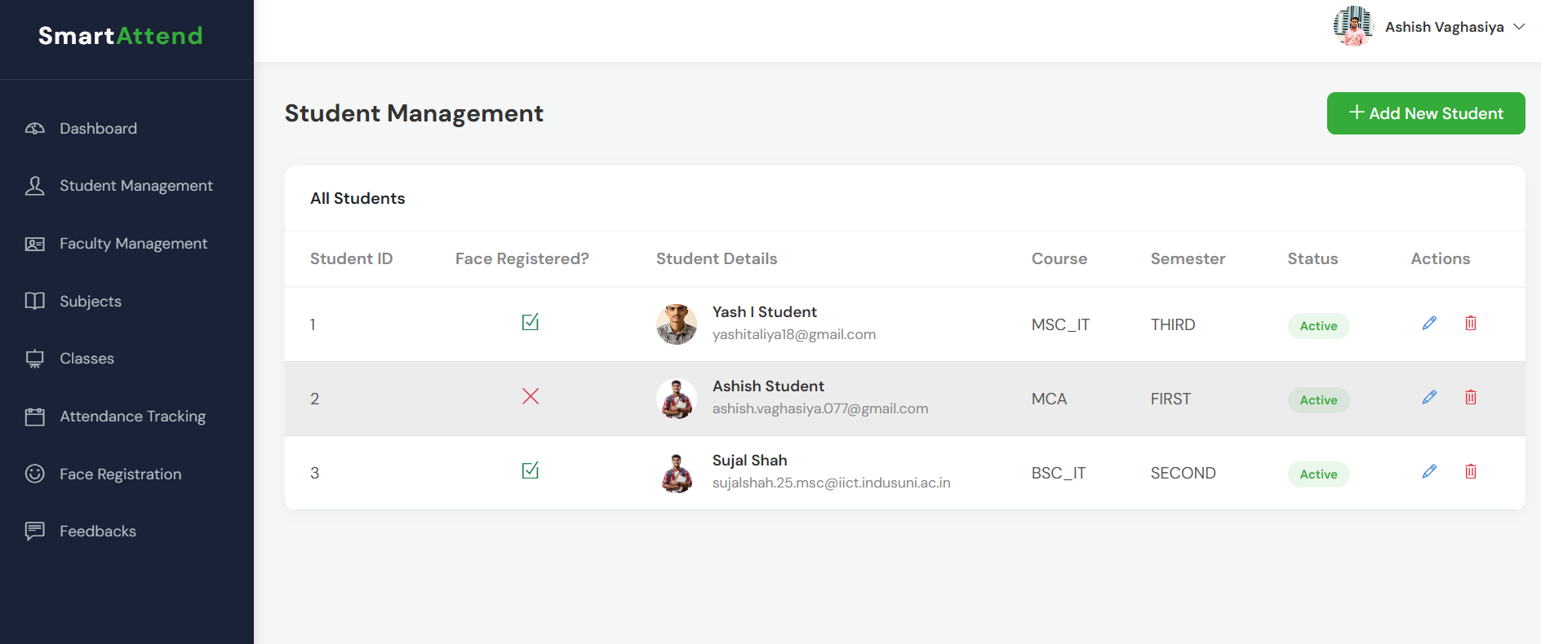
STUDENT MANAGEMENT PAGE (ADMIN SIDE)

Slide 39
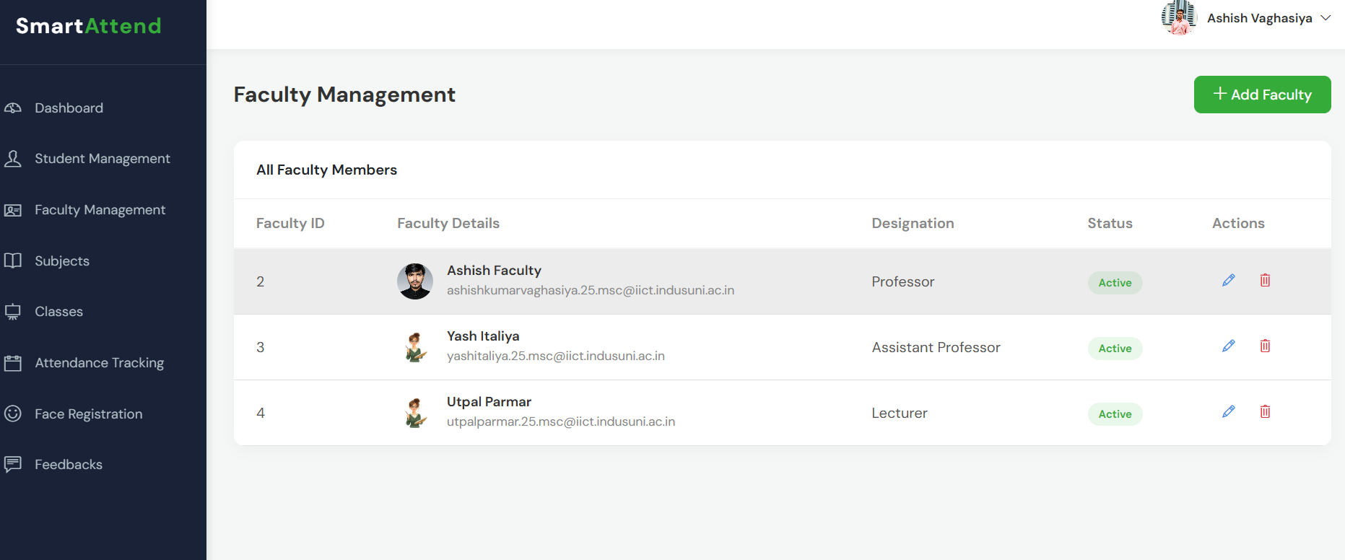
FACULTY MANAGEMENT PAGE (ADMIN SIDE)

Slide 40
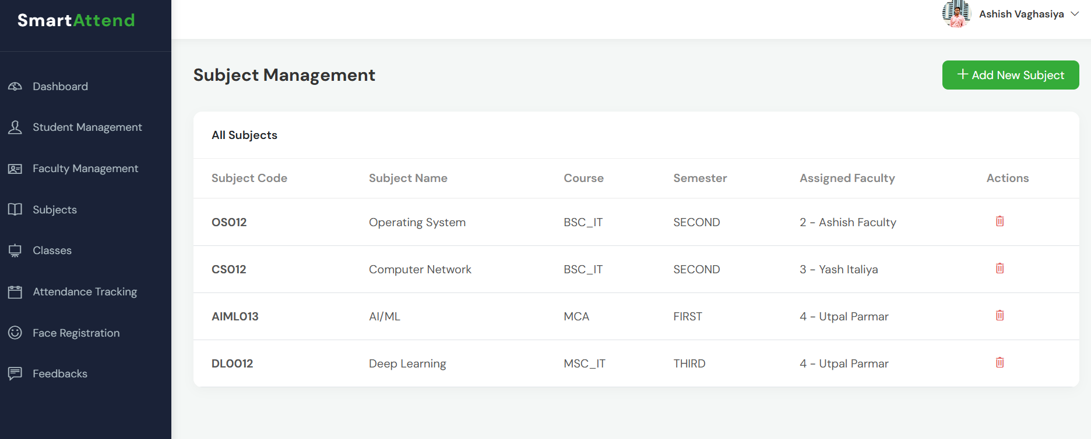
SUBJECT MANAGEMENT PAGE (ADMIN SIDE)

Slide 41
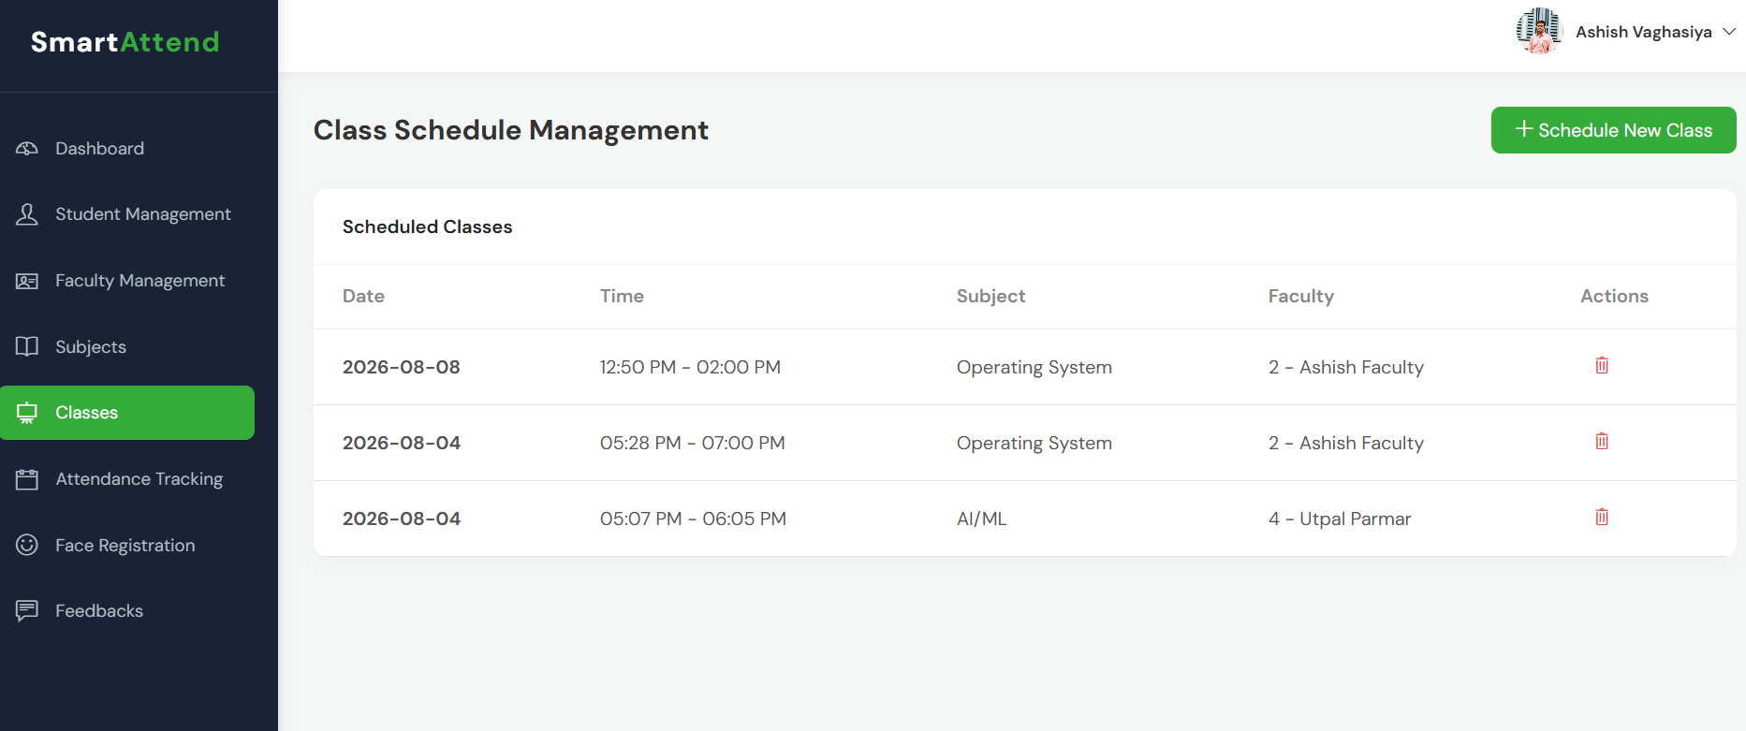
CLASSES MANAGEMENT PAGE (ADMIN SIDE)

Slide 42
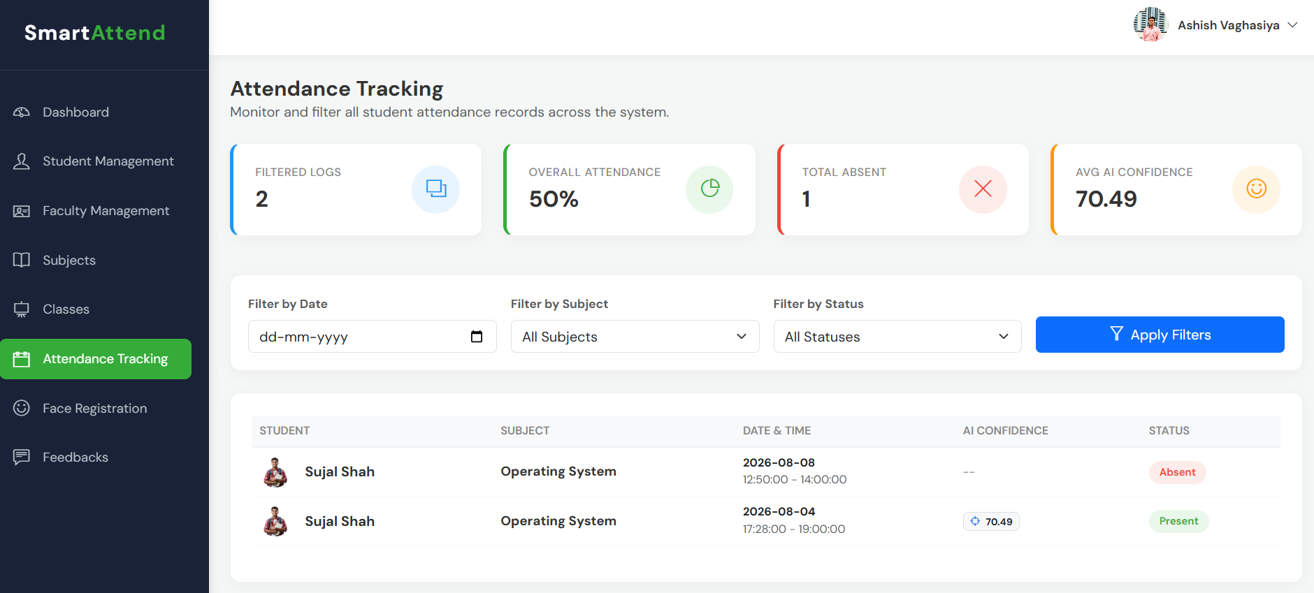
ATTENDANCE TRACKING PAGE (ADMIN SIDE)

Slide 43
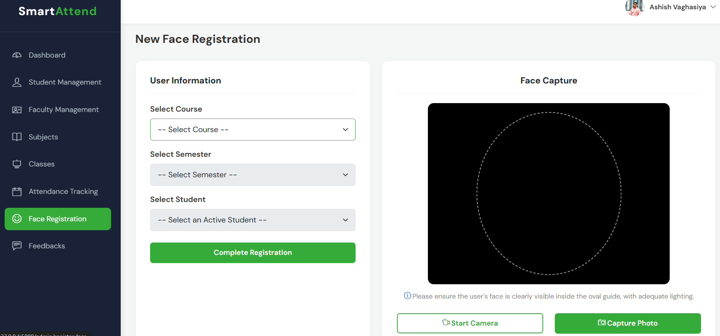
FACE REGISTRATION PAGE (ADMIN SIDE)

Slide 44
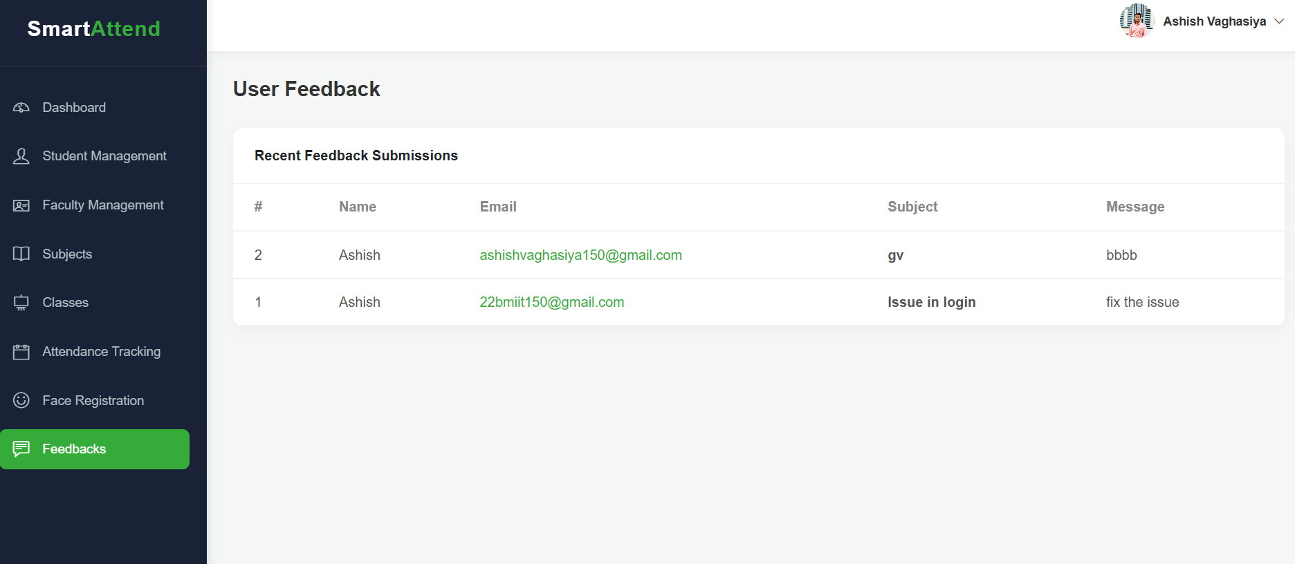
FEEDBACK PAGE (ADMIN SIDE)

Slide 45
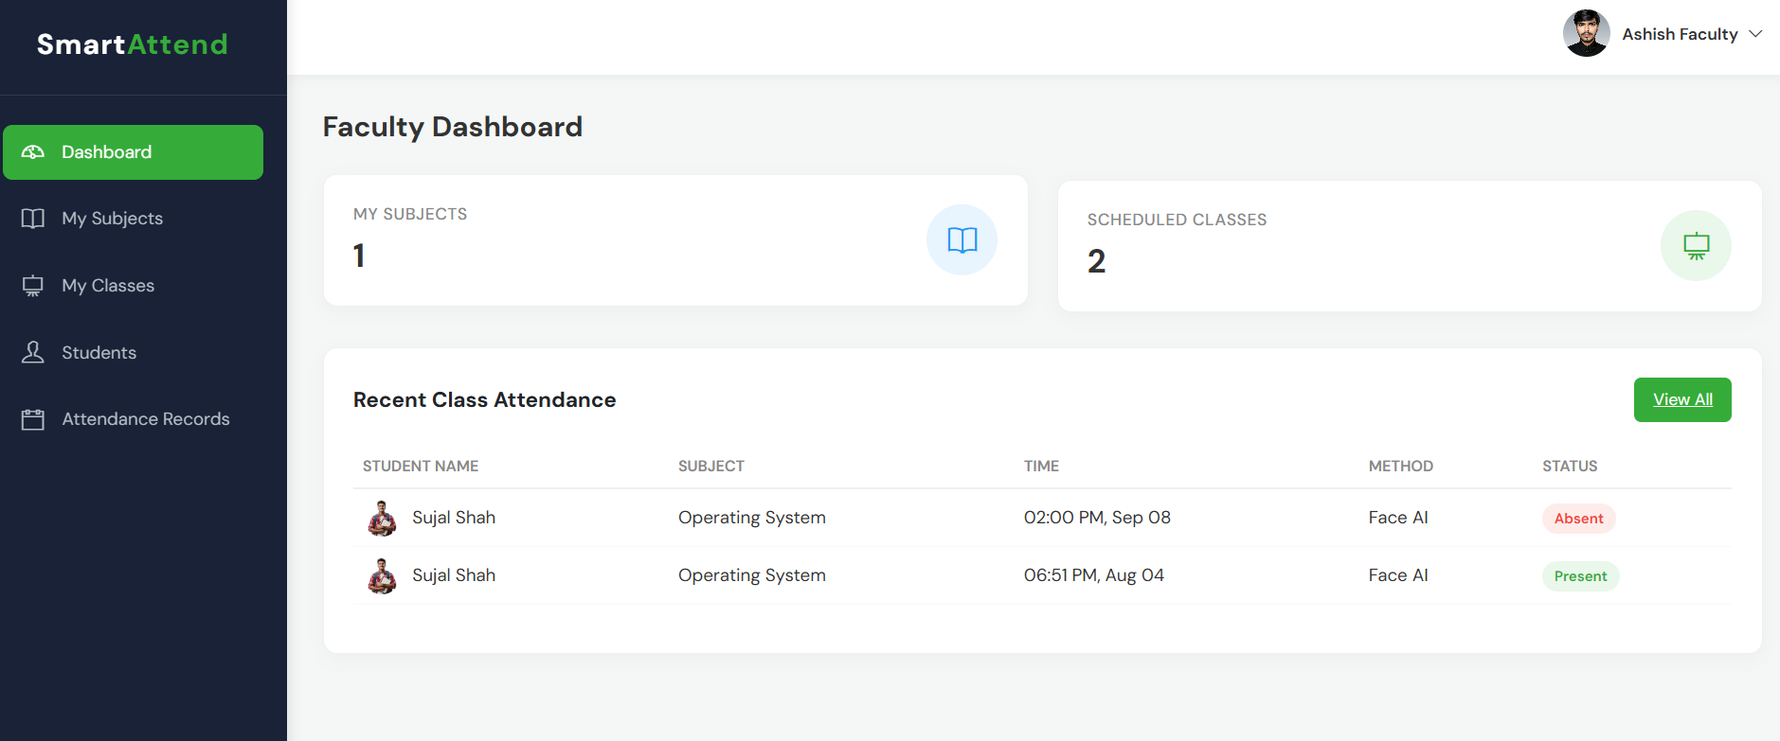
FACULTY DASHBOARD

Slide 46
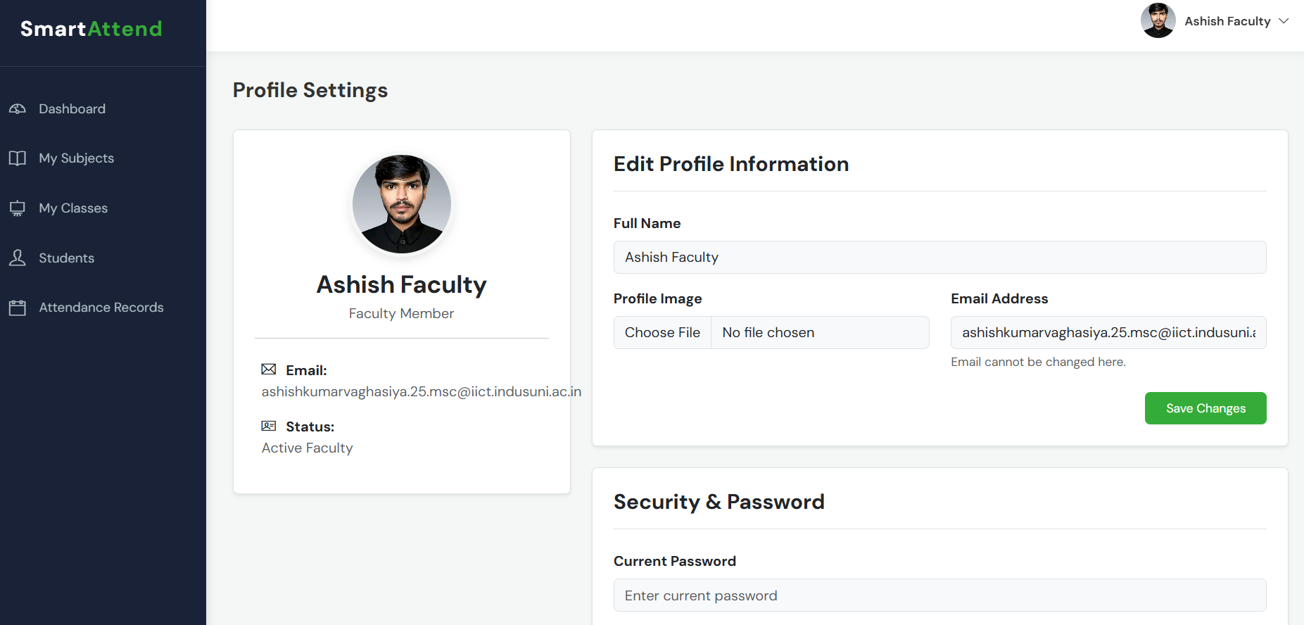
FACULTY PROFILE

Slide 47
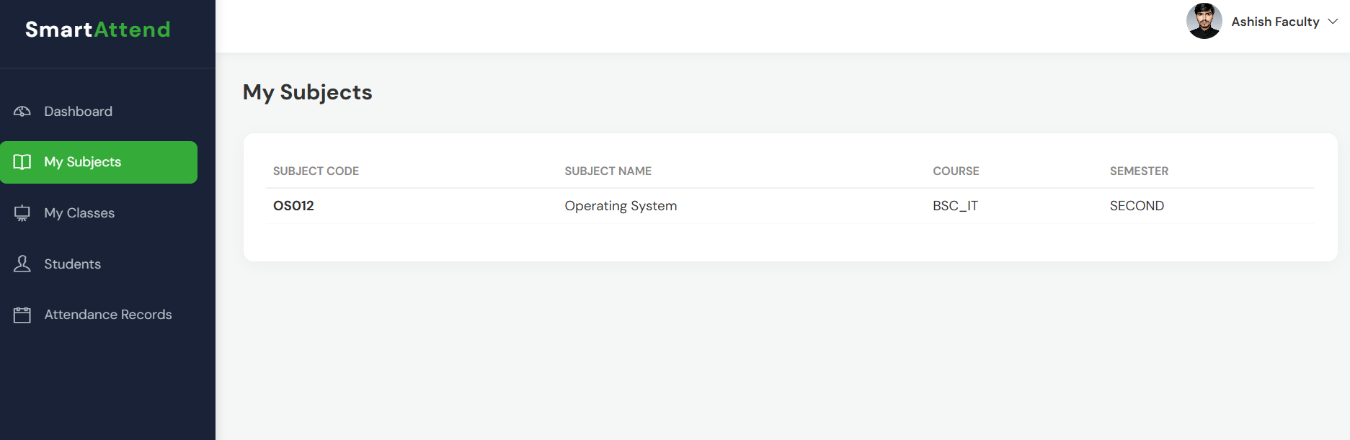
SUBJECTS PAGE (FACULTY SIDE)

Slide 48
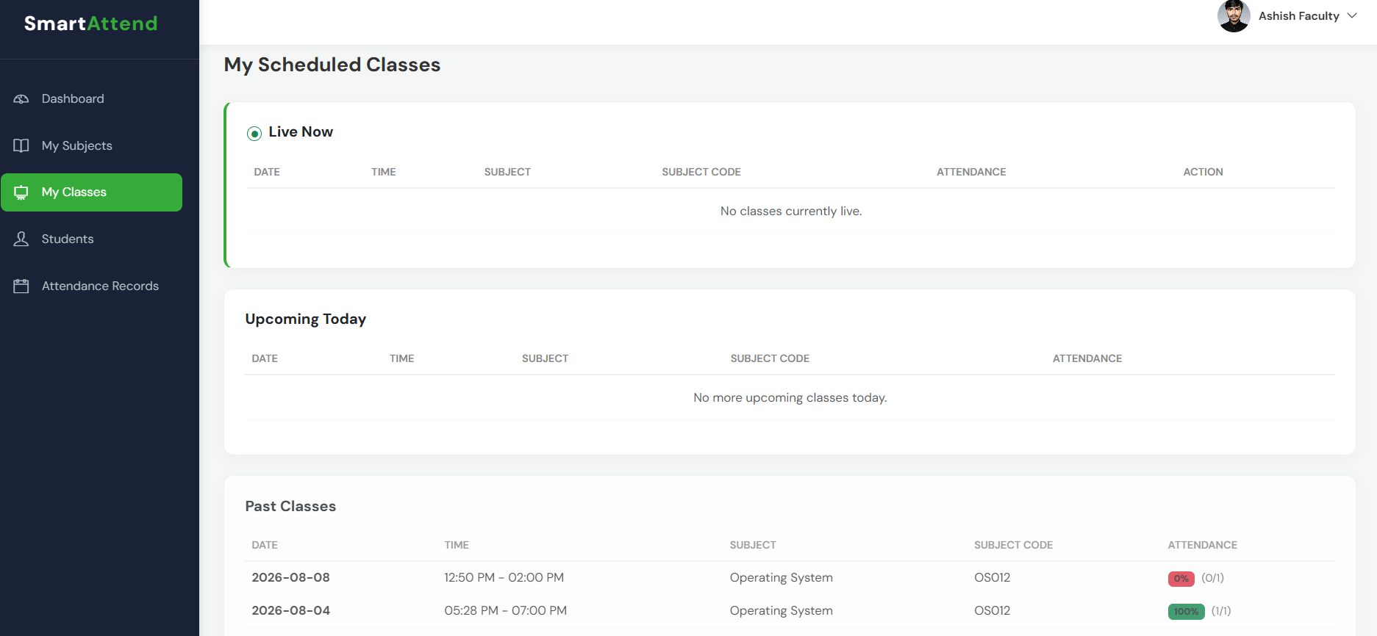
CLASSES PAGE (FACULTY SIDE)

Slide 49
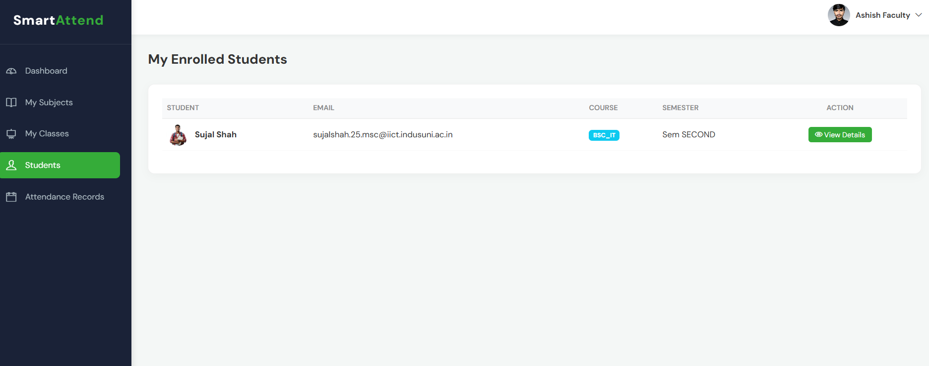
STUDENTS MANAGEMENT PAGE (FACULTY SIDE)

Slide 50
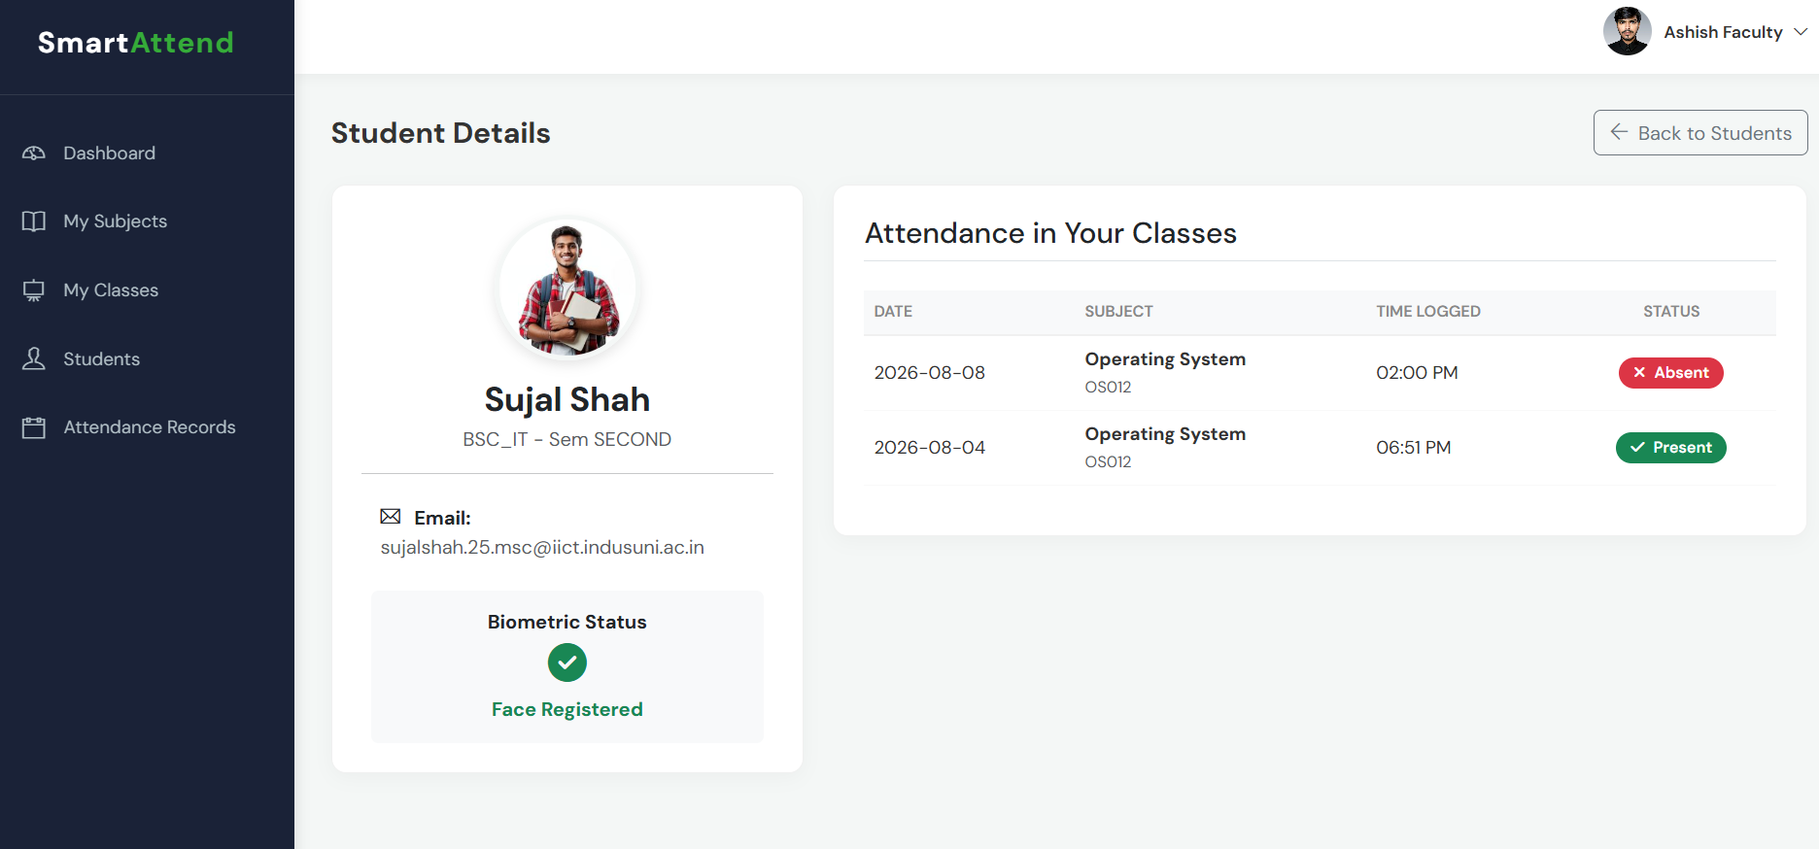
STUDENTS DETAILS PAGE (FACULTY SIDE)

Slide 51
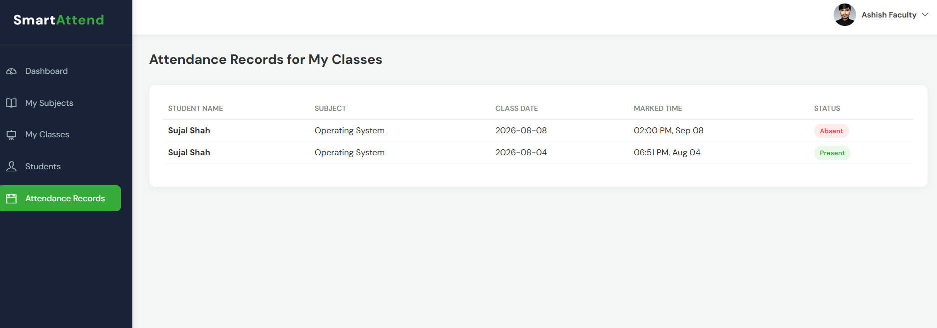
ATTENDANCE TRACKING PAGE (FACULTY SIDE)

Slide 52
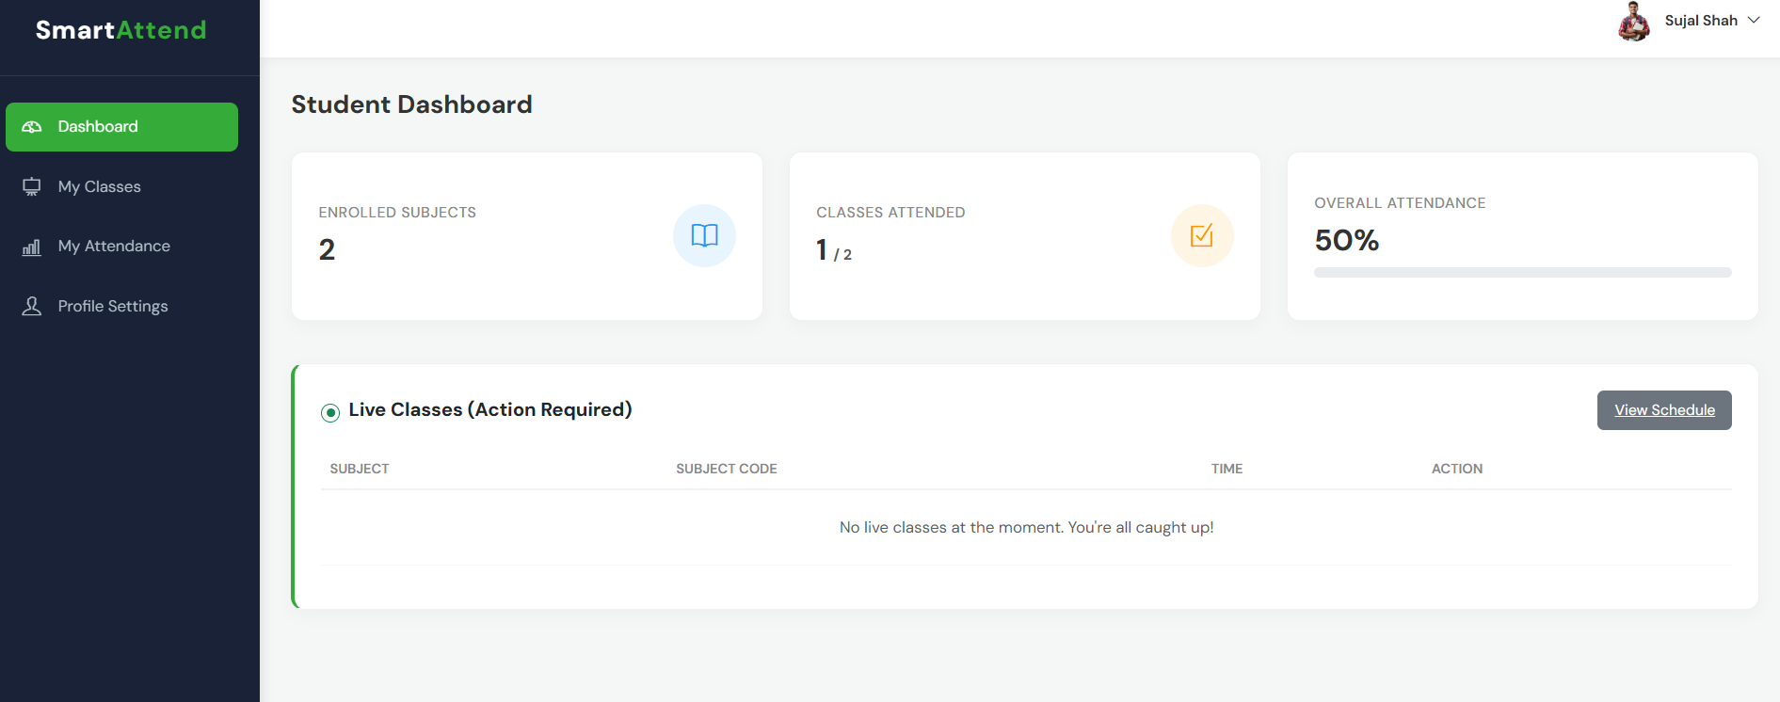
STUDENT DASHBOARD

Slide 53
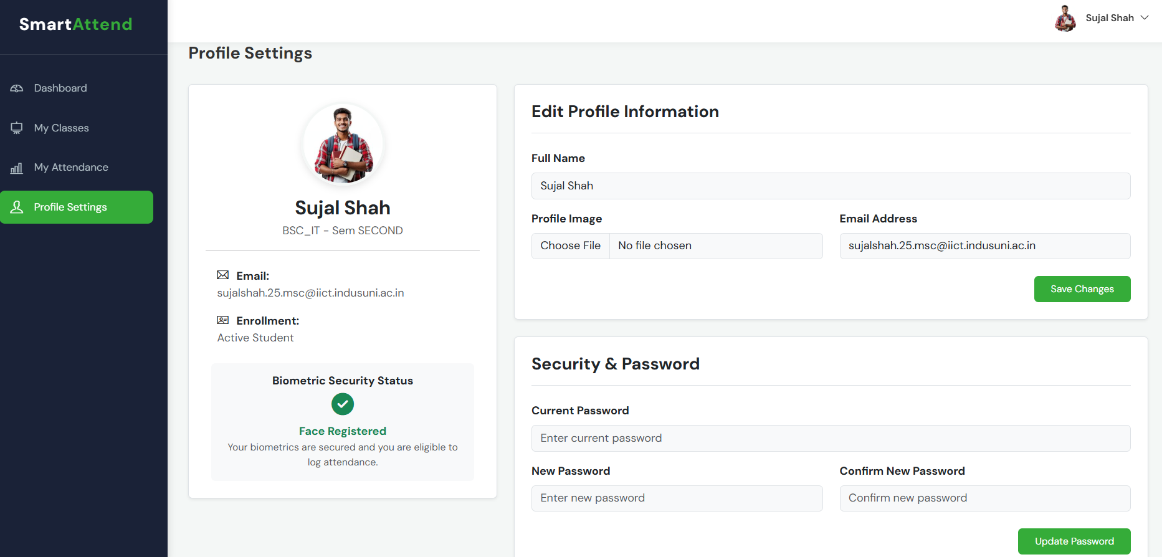
STUDENT PROFILE

Slide 54
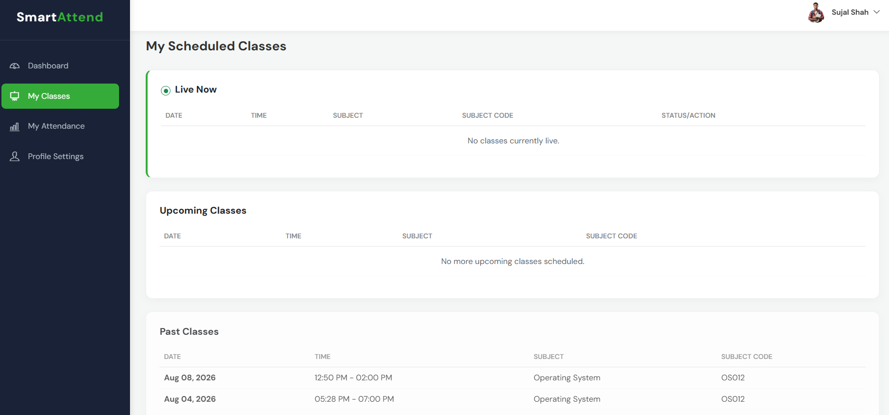
CLASSES PAGE (STUDENT SIDE)

Slide 55
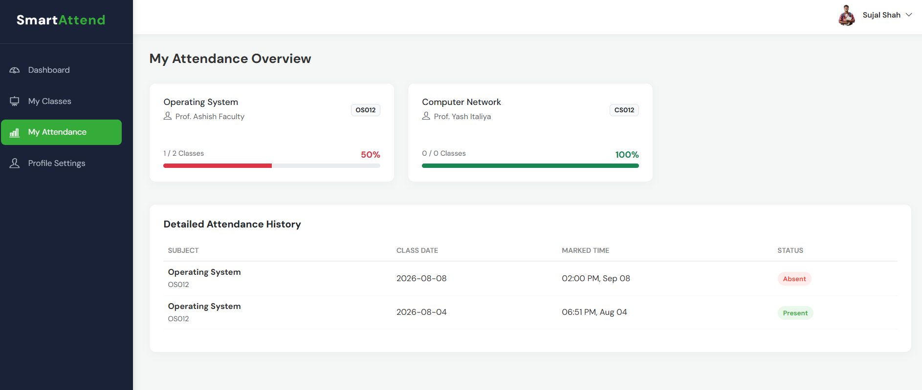
ATTENDANCE TRACKING PAGE (STUDENT SIDE)

Slide 56
THANK YOU

